Slide 1

BASIC PRINCIPLES OF PROJECT MANAGEMENT
Prof. Nguyen Van Hung

Slide 2
Review of PART I
Definitions of project
“A project is a temporary endeavour undertaken to create a unique product, service or result in order to achieve an outcome.”

Slide 3
II. Classification of project
– Official development assistance (ODA)
– NGOs project definition
– Bilateral project
– Loan project

Slide 4
III. Notable project examples
– Bilateral project - USTH
– Loan project - USTH Hoa Lac Campus
– Disaster Prevention Project in Vietnam

Slide 5
Review – Chapter 1 (Part II)
I -Value of Project Management
1 - Evaluation of implemented projects
2 - Value of Project Management
Project management is, in fact, shorthand for project, program and portfolio management.
And more companies are clearly seeing the payoff from investing time, money and resources to build organizational project management expertise : lower costs, greater efficiencies, improved customer and stakeholder satisfaction, and greater competitive advantage.
An Economist Intelligence report showed that 80 percent of global executives believed having project management as a core competency helped them remain competitive during the recession.

Slide 6
II. The Need of Project Management
1- Definition of Project Management
Project management is application of knowledge, skills, tools, and techniques to project activities to achieve project requirements.
Project management is accomplished through the application and integration of the project management processes of initiating, planning, executing, monitoring and controlling, and closing.

Slide 7
Review of Chapter 1 ( PART II )
2- The needs of Project Management
Leading organizations across sectors and geographic borders have been steadily embracing that project management as a way to control spending and improve project results. When the recession began, this practice became even more important.
Executives discovered that adhering to project management methods and strategies reduced risks, cut costs and improved success rates—all vital to surviving the economic crisis.

Slide 8
3- The rules of Project management
The first rule of project management is that the people who must do the work should help plan it.
“Leadership is the art of getting others to want to do something that you believe should be done.” —Vance Packard
It Is Not Just Scheduling!
One-Person Projects
The Big Trap—Working Project Managers
You Can’t Have It All!
C = f(Q, T, S)

Slide 9
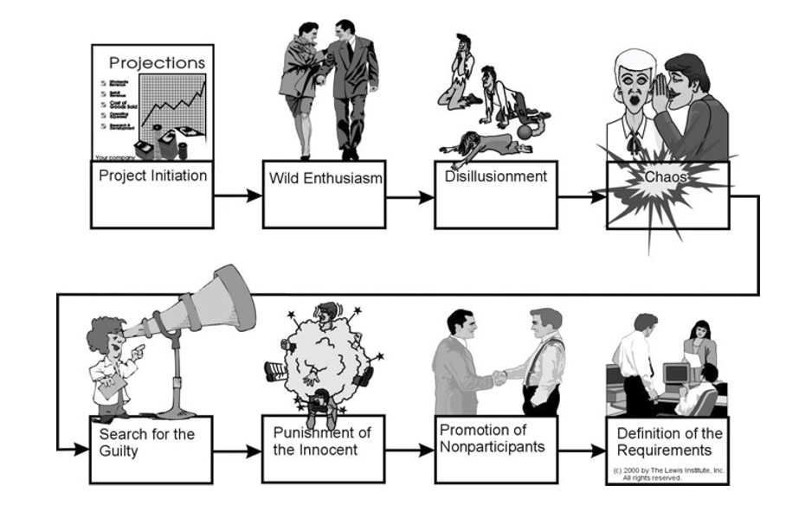
III. The Phases of a Project
Life cycle of a troubled project.

Slide 10
III. The Phases of a Project
Definition Phase
5 Basic Phases of Project Management
1. Project conception and initiation
2. Project definition and planning
3. Project launch or execution
4. Project performance and control
5. Project close

Slide 11
IV. The Steps in Managing a Project
Define the Problem
(Sự xác định rõ nhiệm vụ của Dự án)
Develop Solution Options
(Triển khai giải pháp lựa chọn)
Plan the Project
(Lập kế hoạch Dự án)
Execute the Plan
(Thực hiện kế hoạch Dự án)
Monitor and Control Progress
(Khảo sát và kiểm tra quá trình thực hiện Dự án)
Close the Project
(Kết thúc Dự án)

Slide 12
The Project Management Body of Knowledge
(Kiến thức Chuẩn mực về quản lý Dự án)
Project Processes
(Các qui trình của Dự án)
Initiating
(Sự khởi động Dự án)
Planning
(Kế hoạch thực hiện Dự án)
Executing
(Quá trình thực hiên Dự án)
Monitoring and Controlling
(Theo dõi và quản lý công việc)
Closing
(Kết thúc Dự án)

Slide 13
Knowledge Areas
(Lĩnh vực kiến thức về quản lý dự án)
Project Integration Management
Project Scope Management
Project Cost Management
Project Quality Management
Project Human Resources Management
Project Communications Management
Project Risk Management
Project Procurement Management

Slide 14
Lecture 3 – PART II
PROJECT MANAGEMENT BASICS
Chapter 2
Manager, Organization, and Team in project management

Slide 15
A – Project Manager
1- Overview
1.1- A project manager is a person who has the overall responsibilities for:
the successful initiation
planning
design
execution
monitoring
controlling
closure of a project

Slide 16
1- Overview
1.2- Requirements for project managers:
* The project manager must have a combination of skills including an ability to ask penetrating questions, detect unstated assumptions and resolve conflicts, as well as more general management skills.
* Key among a project manager's duties is the recognition that risk directly impacts the likelihood of success and that this risk must be both formally and informally measured throughout the lifetime of a project.

Slide 17
1- Overview
1.3 The Risks of projects
Risks arise from uncertainty !
The successful project manager is the one who focuses on this as their primary concern.
Most of the issues that impact a project result in one way or another from risk.
A good project manager can lessen risk significantly, often by adhering to a policy of open communication, ensuring every significant participant has an opportunity to express opinions and concerns.

Slide 18
1- Overview
1.3 Risks of Projects ( continued )
* A project manager is a person who is responsible for making decisions, both large and small. The project manager should make sure they control risk and minimize uncertainty. Every decision the project manager makes must directly benefit their project.
* Project managers use project management software, such as Microsoft Project, to organize their tasks and workforce. These software packages allow project managers to produce reports and charts in a few minutes, compared with the several hours it can take if they do it by hand.

Slide 19
2- The project manager roles and Responsibilities
The role of the project manager encompasses many activities including:
Planning and Defining Scope
Activity Planning and Sequencing
Resource Planning
Developing Schedules
Time Estimating
Cost Estimating
Developing a Budget
Documentation

Slide 20
2- The project manager roles and Responsibilities
Creating Charts and Schedules
Risk Analysis
Managing Risks and Issues
Monitoring and Reporting Progress
Team Leadership
Strategic Influencing
Business Partnering
Working with Vendors
Scalability, Interoperability and Portability Analysis
Controlling Quality
Benefits Realize

Slide 21
2- The project manager roles and responsibilities
The primary responsibility of the project manager is to ensure that all work is completed on time, within budget and scope, and at the correct performance level
Project managers must understand the mission and vision of the organization first, then they must see how the project they are managing meshes with the organization’s mission, and they must steer the project to ensure that the interests of the organization are met.
Notes:
Mesh: khớp nhau

Slide 22
Another Roles
* Facilitator
Manager-as-supervisor versus manager-as-facilitator
Systems approach versus analytical approach
Must ensure project team members have appropriate knowledge and resources
Micromanagement

Slide 23
Three Overriding Responsibilities
Acquiring resources
  Getting necessary quantity and quality can be key challenge
  “Irrational optimism”
Fighting fires and obstacles
Leadership and making trade-offs

Slide 24
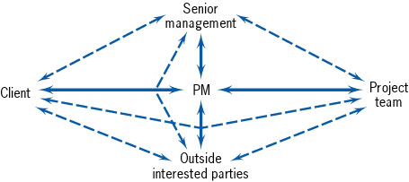
* Project Manager is a Communicator
Communication Paths Between a Project’s Parties-At-Interest

Slide 25

Tasks of Virtual Project Manager
Geographically dispersed projects
Communication via
  Email
  Web
  Telephone
  Video conferencing
“Never let the boss be surprised!”

Slide 26

Negotiation, Conflict Resolution, and Persuasion
Necessary to meet three overriding responsibilities

Slide 27
SELECTION OF A PROJECT MANAGER

Slide 28
Key Criteria
Credibility - The PM is believable
  technical credibility
  administrative credibility
Sensitivity - Politically astute and aware of interpersonal conflict
Leadership, Style, Ethics - Ability to direct project in ethical manner

Slide 29
Leadership
Leadership is the art of getting others to WANT to do something that you believe should be done (Packard, 1962).
Since you have very little authority anyway, consider the job to ensure that everyone in the project team has what they need to do their job well.
“People skills”: if you can deal with people, you can either learn to do everything else or delegate it to someone who can do it.

Slide 30
Do you really want to be a project manager?
Do you like having responsibility with very limited authority?
Do you enjoy working to impossible deadlines, with limited resources, and unforgiving stakeholders?

Slide 31
B – Project Organization
1- What is an Organization?
*An organization is a group or groups of individuals who share the purpose of accomplishing a goal.
* Each organization is defined by the culture and style, called norms, that they create.
* Cultural norms are shaped by the experiences of the organization and will develop over time.
*The experiences can be items such as risk management, diversity, values, leadership, or accountability.

Slide 32
B – Project Organization
2- Project Organizational Structure Types
*There are three main types of structures to consider when organizing a project:
* Projectised ( pure ) ,Functional and Matrix organizations
*
Each type is characterized by the project manager's authority and role, resource availability, budget responsibility, and whether or not a project management staff is available. Let's discuss each type of project organization.

Slide 33
B – Project Organization
3- Projectised ( Pure ) Organizations
*A projectised (pure) organization is characterized by total project manager authority and dedicated resources. The project manager is full-time and has budget responsibility, and the administrative staff is on the project full-time.
*Projectised organizations are designed solely to run projects, which means that when the project is complete, personnel have to find another project or not have a job. This is both an advantage and disadvantage of the projectised organization. An example of this type of organizational structure would be used in a government project management office (PMO). In this organization, if personnel complete a project, they need to find another project to continue to work.

Slide 34
Projectised ( pure ) Organization
*A " Projectised (pure) organization" is a model of a business where project managers have total control over the project when they are overseas.
*Central control at the managerial level must be weak for this to occur. Put simply, a " projectised (pure) organization" might also be termed a "task force.“
* In the case of a "pure project," the leader of this task force would have to be given total authority for a limited period to solve a particular problem. In business, it is a great challenge to find an example of such purity.

Slide 35
The Task Force
* In politics, the concept of a "task force" that approximates the total control over a specific project under a "manager" of sorts is not hard to find.
* In Latin America, poor and divided governments have struggled to control the drug lords who can outshoot and outspend the state.
* From the 1960s to 2011, Latin American states have dealt both with leftist terrorism and drug violence -- occasionally the same thing, as in Peru -- by either declaring a state of emergency or installing a military government.

Slide 36
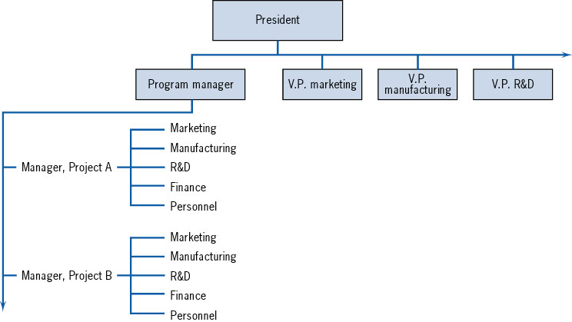
Structure of the Projectised (Pure) Organization

Slide 37
The Projectised (pure) Organization
Advantages
  Effective and efficient for large projects
  Resources available as needed
  Broad range of specialists
  short lines of communication
Drawbacks
  Expensive for small projects
  Specialists may have limited technological depth
  May require high levels of duplication for certain specialties

Slide 38
4- Functional Organizations
*A functional organization is one in which the project manager works on a part-time basis and has minimal authority.
*There are few resources, and a functional manager bears the budget, decision making, and overall responsibility. A project management administrative staff is available, but like the project manager, works part time. This type of organization is grouped by functionality, for instance, marketing, human resources, finance, may be subdivided further into departments. The department level will complete projects separately from other departments. A defining characteristic of the functional organization is that it is a hierarchy with one clear manager or boss.

Slide 39
Functional Organizations
*A functional organization is suited for small companies with different departments that can work independently of each other and can provide limited services or goods. *Advantages of functional organizations include clear direct authority, direct career development and experience, strong technical ability, and resource flexibility.
*There are a few disadvantages of the functional organization. For example, no one is solely accountable for the project, projects are not emphasized, and there can be plenty of politicking in the organization.

Slide 40
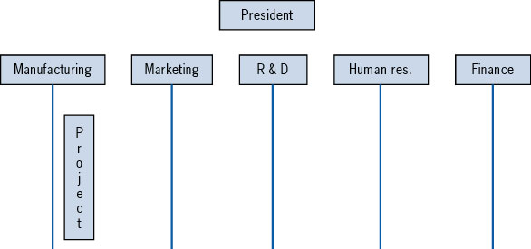
Structure of Functional Project Organization

Slide 41
Functional Project Organization
Advantages
  technological depth
Drawbacks
  lines of communication outside functional department slow
  technological breadth
  project rarely given high priority

Slide 42
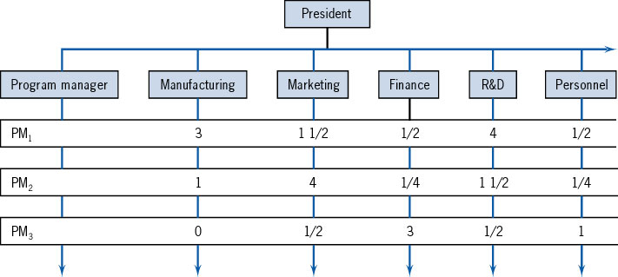
Matrix Project Organization

Slide 43
Matrix Project Organization
Advantages
  flexibility in way it can interface with parent organization
  strong focus on the project itself
  contact with functional groups minimizes projectitis
  ability to manage fundamental trade-offs across several projects
Drawbacks
  violation of the unity of command principle
  complexity of managing full set of projects
  conflict

Slide 44
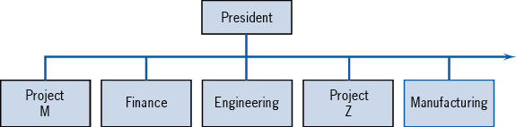
Mixed Project Organization

Slide 45
THE PROJECT TEAM

Slide 46
Characteristics of Effective Project Team Members
Technically competent
Politically sensitive
Problem orientation
Goal orientation
High self-esteem

Slide 47
Matrix Team Problems
Weak (functional) matrix
  PM has no direct reports
  Ability to communicate directly with team members important
Matrix projects
  Important to maintain good morale
  Project office

Slide 48
Intrateam Conflict
Life cycle phase and source of conflict
Name-only team
Interpersonal conflict

Slide 49
MULTIDISCIPLINARY TEAMS -- BALANCING PLEASURE AND PAIN

Slide 50
Concurrent Engineering
Carrying out steps concurrently rather than sequentially
  also referred to as simultaneous engineering
Key advantages
  helps minimize conflict across functional groups
  reduces project duration

Slide 51
Interface Coordination -- Interface Management
Key challenge facing PM is coordinating work of different functional groups.
One approach is to identify and map the interdependencies between members of the project team.

Slide 52
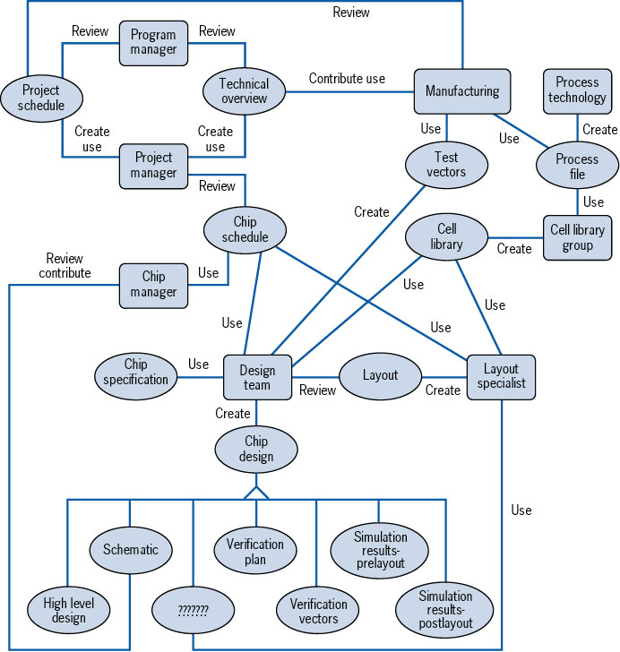
An Interface Mapping of a Silicon Chip Design Project

Slide 53
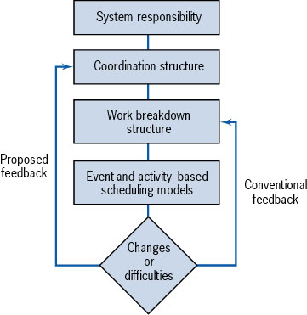
A Coordination Structure Model for Project Management

Slide 54
Design Structure Matrix (DSM)
Traditional project management tools tend to focus on which tasks have to be completed in order for other to start
Another important question is what information is needed from other tasks to complete another task

Slide 55
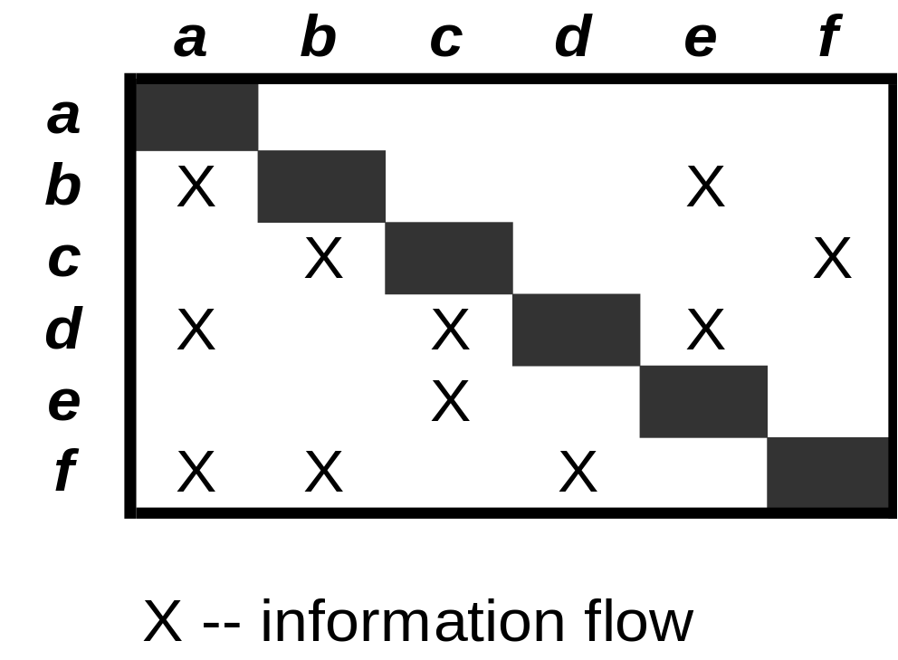
Example DSM for Project with Six Activities

Slide 56
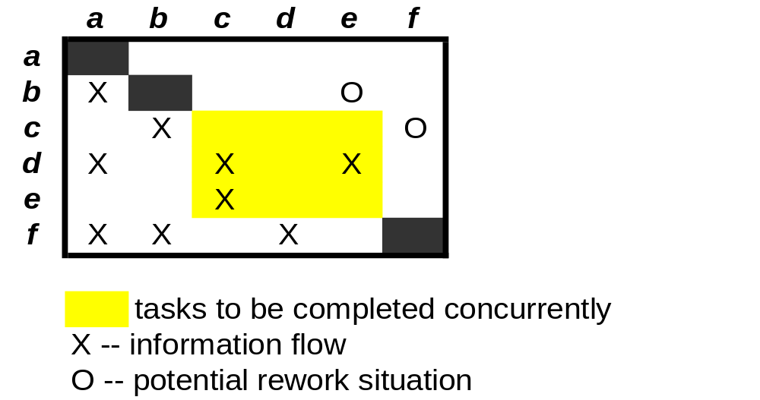
Modified DSM to Show Activities to Be Completed Concurrently

Slide 57
Comments on Empowerment and Work Teams
Participatory management
Success of empowered teams depends heavily on how team program implemented

Slide 58
Advantages of Empowerment
High quality solutions
Avoid micromanagement
Team has accountability for part of project deliverable
Synergistic solutions
Tool for timely evaluation and feedback

Slide 59
Question for the Preparation of the Final Exam
1-Which are the roles and responsibilities of a Project Manager ?
2-What is the leadership ?
3-What is an organization ?
4-How many types of Structures to consider when organizing a project ? Which are they ? (only the title )

